Slide 1

Spiritual Care: It is just not what it used to be!

Slide 2


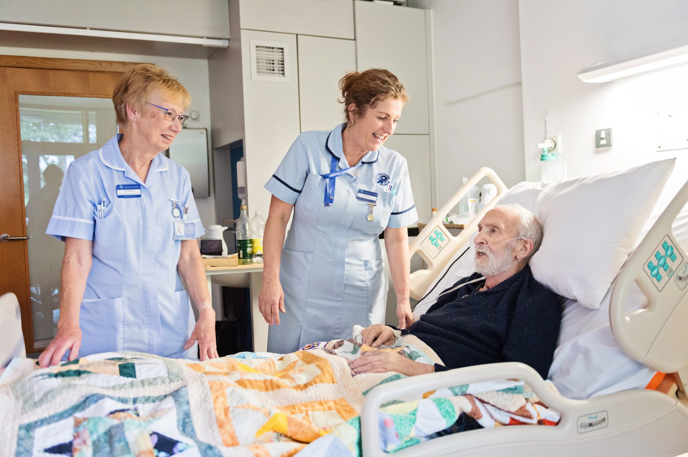

Slide 3
What actually helps here?

Slide 4
Historical Foundations

Slide 5
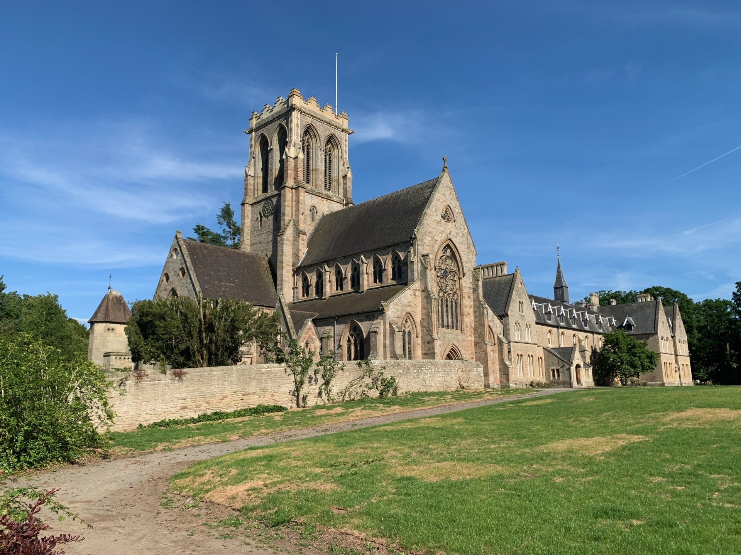

Slide 6


Slide 7
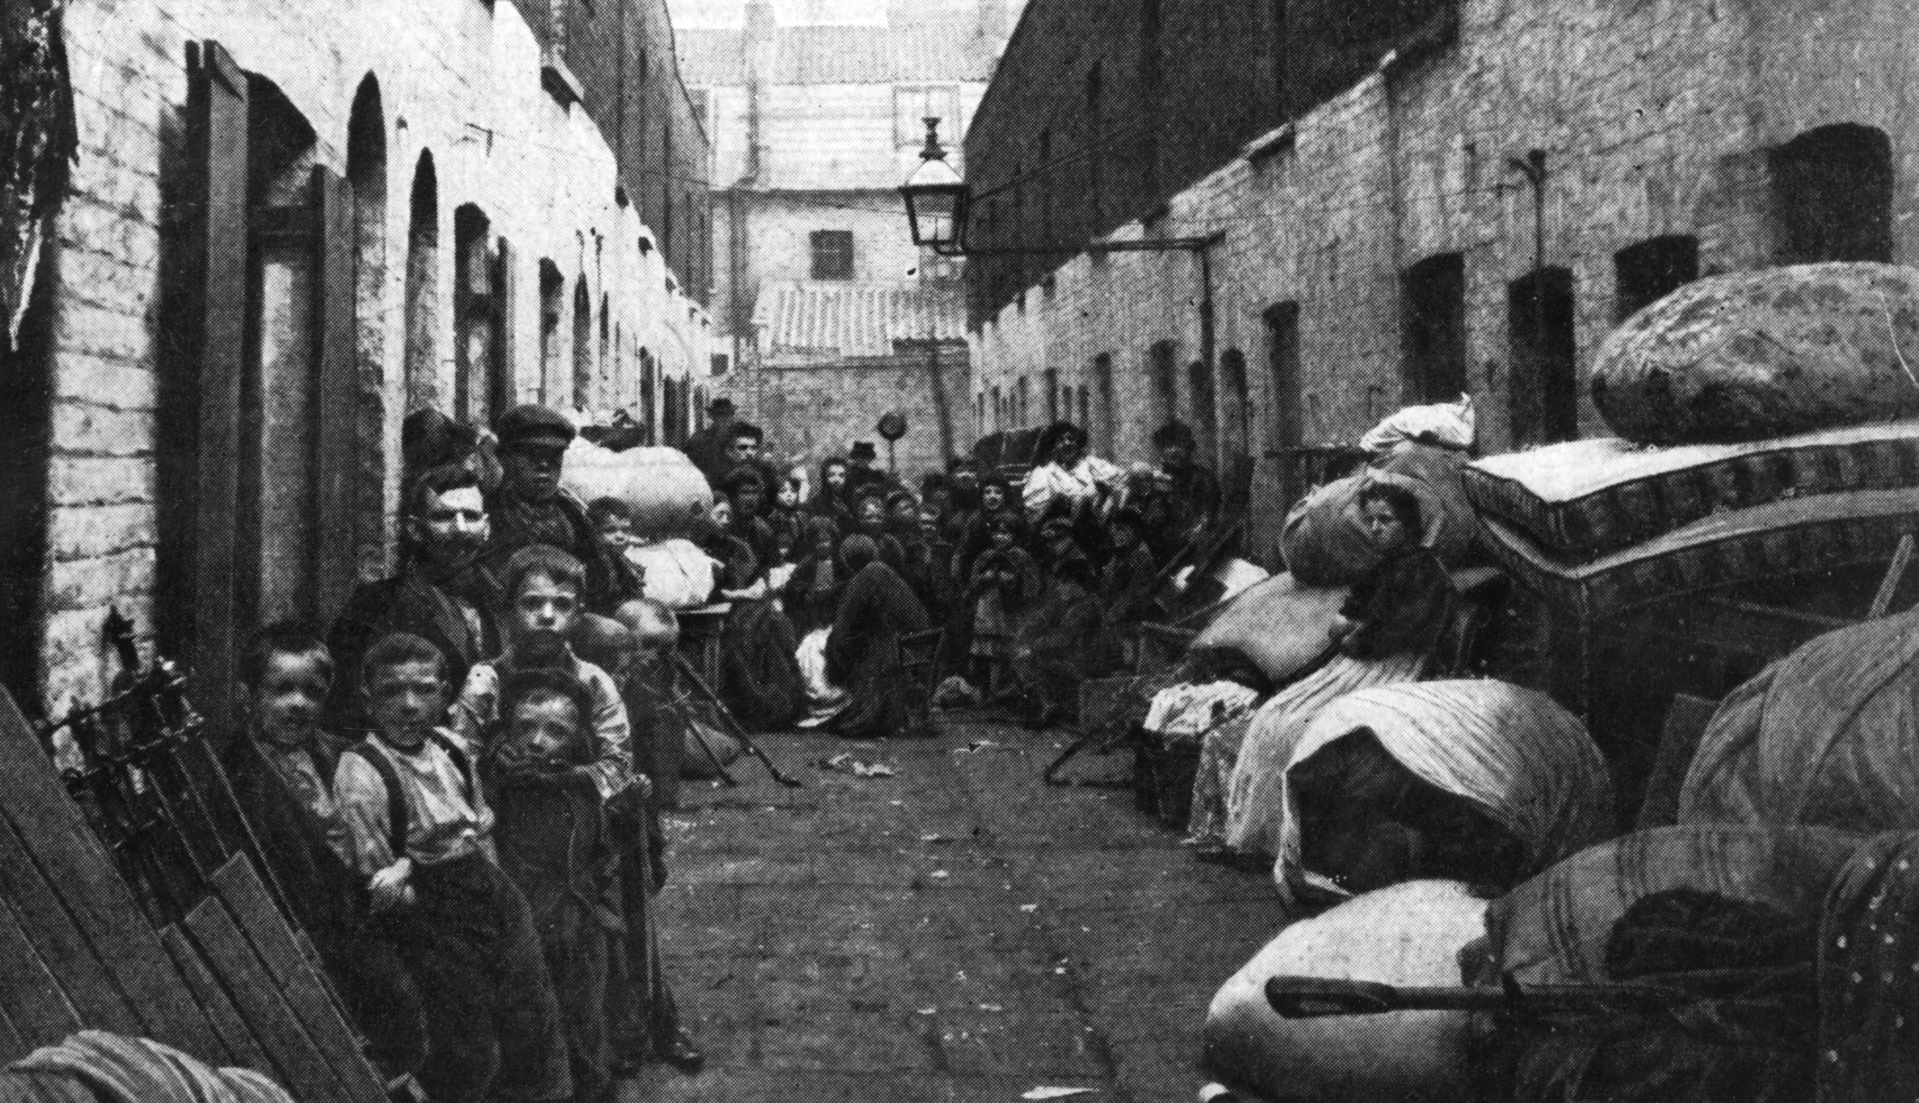

Slide 8
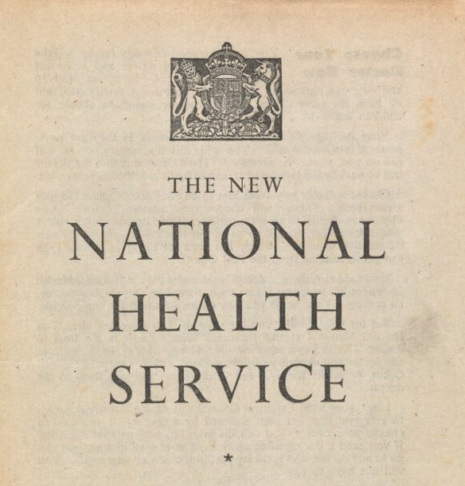

Slide 9
Cultural & Sociological Shifts

Slide 10
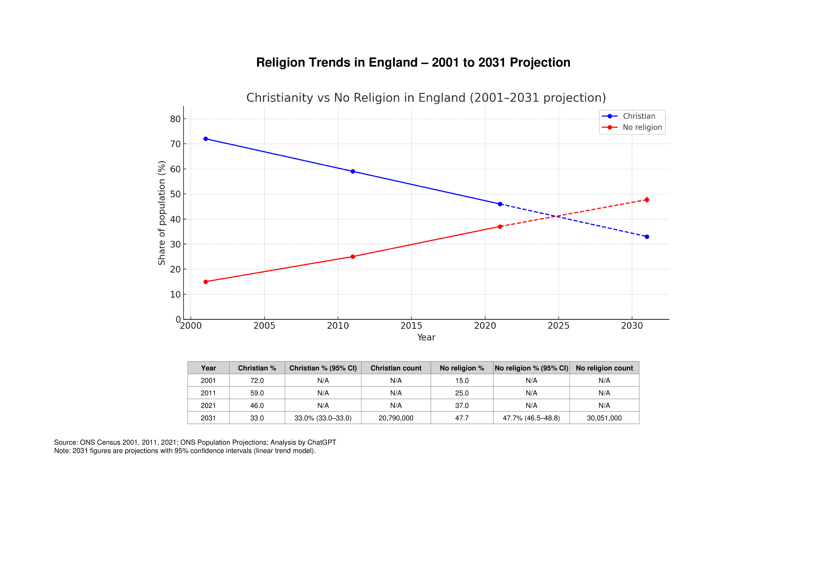

Slide 11
Professionalisation

Slide 12


Slide 13
“My role is to listen with unconditional regard, helping the patient articulate their meaning”

Slide 14


Slide 15
Hospice & Psycho-Spiritual Care

Slide 16
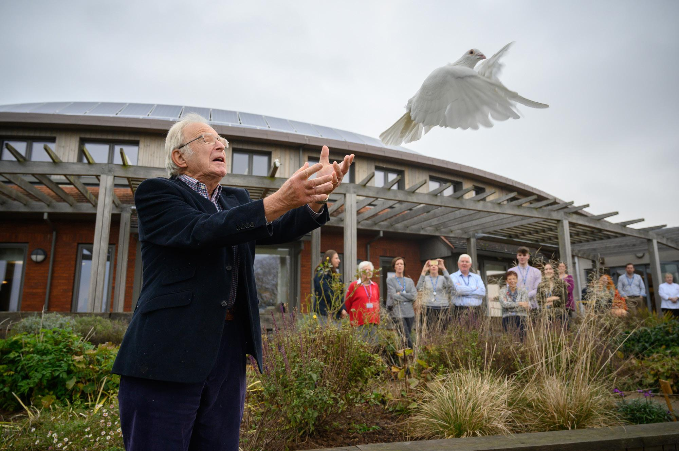
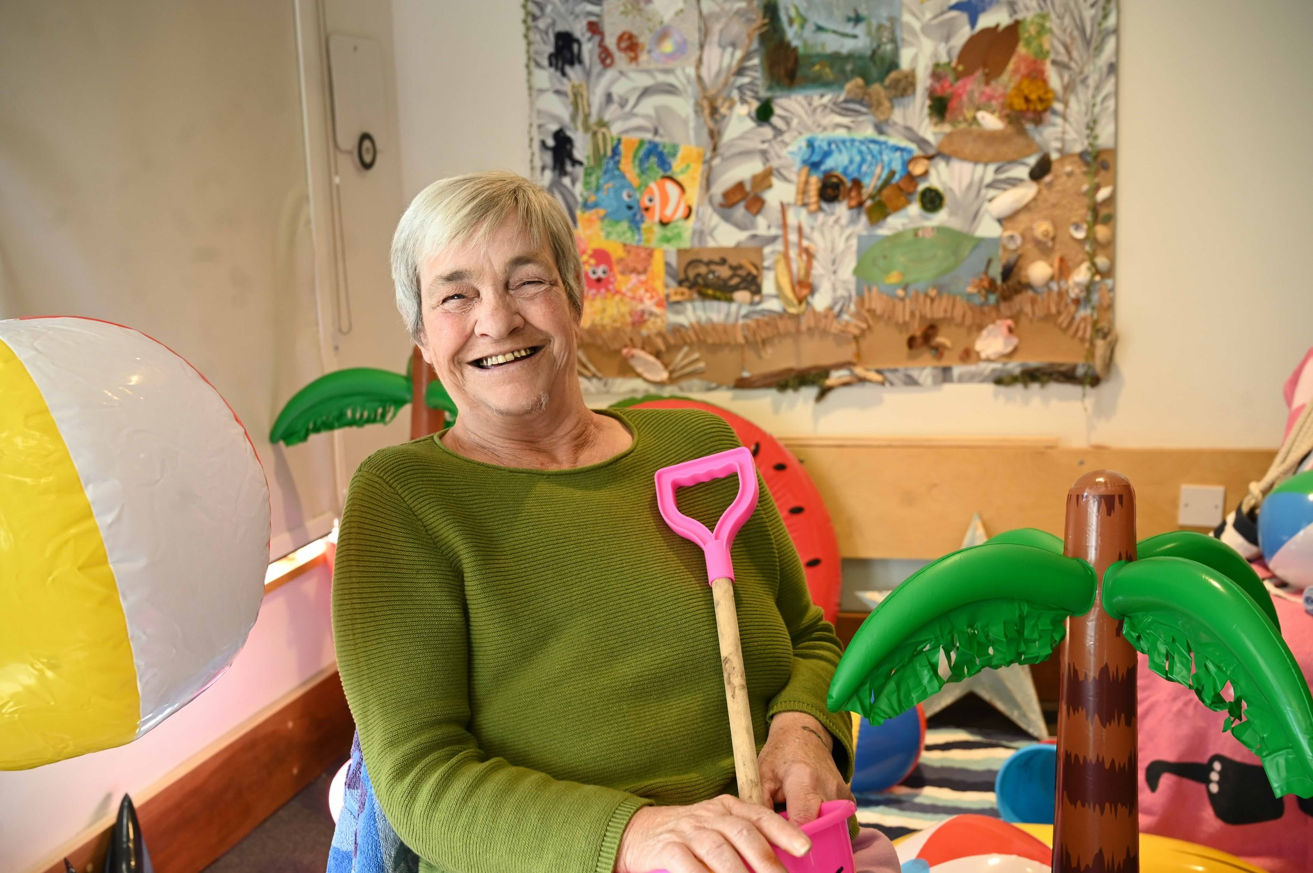


Slide 17
Why me?
What has my life meant?
What happens next?
Will those I love be okay?

Slide 18


Slide 19
Future Models

Slide 20
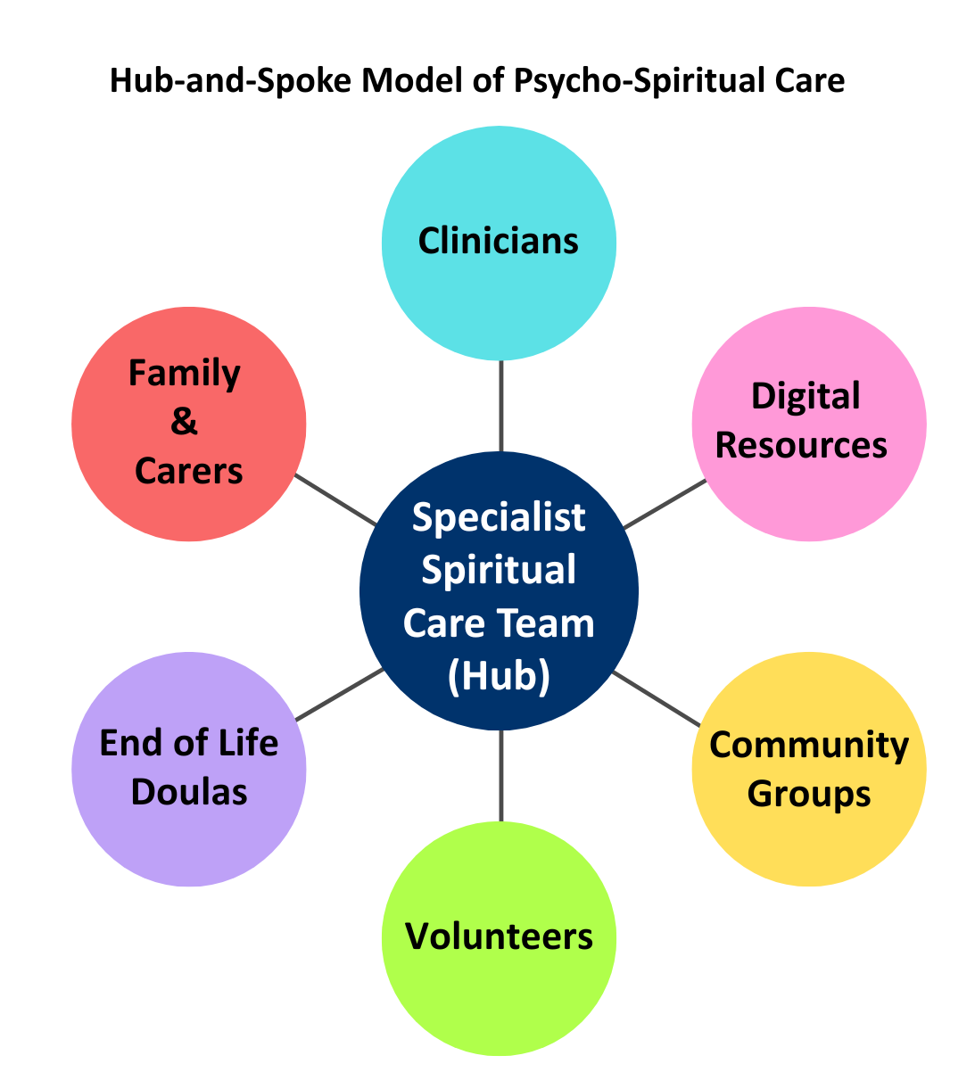
Hub-and-Spoke Model of Psycho-Spiritual Care

Slide 21
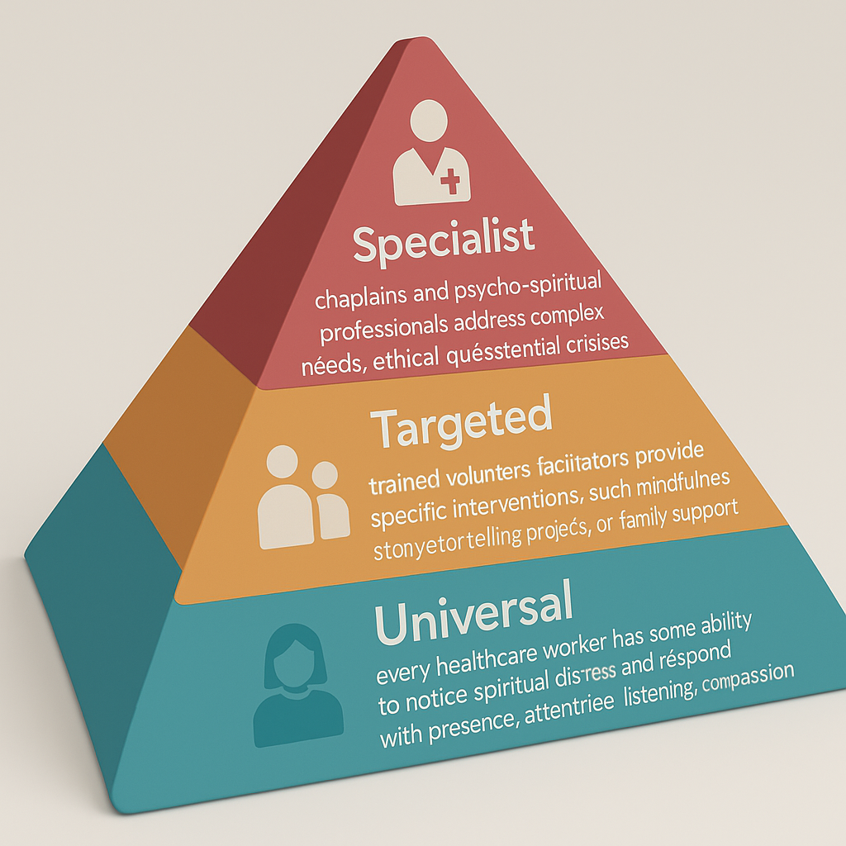

Slide 22
What actually helps here?

Slide 23
“Do you want a blessing?”
“What blesses you?
‘What matters most to you?”

Slide 24

Thank you for listening

Slide 25


